Slide 1
New York State Hotel & Airbnb Analysis
Naibo Hu(Ray), Fan Fei(Fiona), Zihao Liu, Pengfei Gu(David)

Slide 2
Table of Contents
01
02
Executive Summary
Business Use Case
03
04
Data Profile & Quality
Tools & Methodology
05
06
Analysis & Insights
Recommendations &
Lessons Learned
07
08
Our Team
Appendix & Reference

Slide 3
01 Executive Summary
Executive Summary| Business Use Case | Data Profile & Quality | Tools & Methodology | Analysis & Insights | Recommendations & Lessons Learned| Our Team | Appendix
The hospitality industry just experienced recession due to COVID-19 and is currently in a recovery stage. As people start to travel more, they face the problem of finding comfortable residences, convenient dine-in options, as well as safe environment.
Our group aims to analyze and visualize factors that characterize high quality hotels and Airbnbs in New York State and provide travellers with optimal decision that best suit their needs.
To provide insights that are data-driven and unbiased for decision making, our project will use Python, OpenRefine, R, Google Cloud Platform, SQL, and Tableau for data processing, data analysis, and data visualization.

Slide 4
02 Business Use Case
Executive Summary| Business Use Case | Data Profile & Quality | Tools & Methodology | Analysis & Insights | Recommendations & Lessons Learned| Our Team | Appendix
Travellers
Travellers can quickly access the information about hotel and Airbnb distribution across NY. Travellers can also filter out preferred residential options based on price, star-rating, room type, location, etc.
Hotel Developers & Airbnb Owners
Our statistical model studies factors impacting popularity and price of hotels and Airbnb. Hotel developers and Airbnb hosts can utilize the models to determine pricing range and ideal locations to open their business.
Our data analysis can further guide consumers’ decision with tailored recommendation through accessing other information such as personal dining choices, other cost-efficient substitutes purposes of their trips.
Notes:
Need modification
By using the data we analyzed, it would be great for individuals and large companies to filter out the properties that they like/dislike. In addition, it also helps people who wants to enter the hospitality field.

Slide 5
03 Data Profile
Executive Summary| Business Use Case | Data Profile & Quality | Tools & Methodology | Analysis & Insights | Recommendations & Lessons Learned| Our Team | Appendix
Dimensions
Size & Structure
Source
Matching Rules
11 attributes, 1,632 observations
218 KB Semi-structured
Google Dataset Search
Join with hotel_properties_ny on address
hotels_ny.csv
hotel_properties_ny.csv
20 attributes, 5,520 observations
855 KB Semi-structured
NYC Open Data
Join restaurant_ny on borough
airbnb_ny.csv
18 attributes, 36,924 observations
5391 KB Semi-structured
Inside Airbnb
Join hotel_properties_ny on borough
restaurant_ny.csv
9 attributes, 383,030 observations
83,829 KB Semi-structured
NYC Open Data
Join airbnb_ny on borough
Notes:
Datasets will be matched through zip code, city, longitude, and latitude. All 8 datasets are from different sources, including data world, google dataset search, nyc open data, inside airbnb, and data.ny.gov.

Slide 6
03 Data Quality
Executive Summary| Business Use Case | Data Profile & Quality | Tools & Methodology | Analysis & Insights | Recommendations & Lessons Learned| Our Team | Appendix
Completeness
Validity
Uniqueness
Any missing values?
Does data match the rules?
Are there duplicate values?
Hotel_properties_ny.csv and airbnb_ny.csv have issues with names missing or no data
All fields are checked and formatted to be the appropriate data type in our database.
All hotels in hotels_ny.csv are unique. The rest datasets have repetitive rows but were removed.
Consistency
Timeliness
Accuracy
Consistent across various data stores?
Does data represent reality from required point in time?
Degree to which data represents reality
All data is stored in and sourced from GCP, so it is consistent for all users in MySQL & Tableau.
Hotel_ny.csv is from 2017, but hotel information will not change significantly over time. The last update time for rest datasets is between 2020 and 2021.
Hotels, Airbnbs, and restaurants ratings can be biased based on customers’ experience.

Slide 7
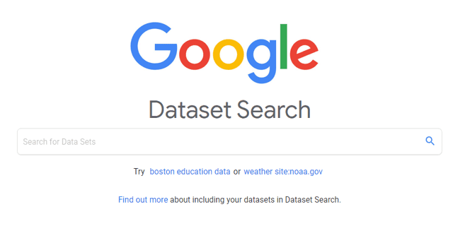













04 Data Tools used
Executive Summary| Business Use Case | Data Profile & Quality | Tools & Methodology | Analysis & Insights | Recommendations & Lessons Learned| Our Team | Appendix
Analysis
Data Extraction
Data Cleaning
Database Design
Analysis
Visualization
Visualizations of the data are shown through Tableau and neo4j
MySQL Workbench and Google Cloud Platform are used to create a relational database and to store our data.
OpenRefine, Excel, Python Numpy and pandas packages are used to process, organize and reformat the data
R studio, MongoDB, and MySql Workbench are used to generate insights from data

Slide 8
04 Data Processing (ETL)
Executive Summary| Business Use Case | Data Profile & Quality | Tools & Methodology | Analysis & Insights | Recommendations & Lessons Learned| Our Team | Appendix
Tables After Normalization
Dataset
Preprocessing Steps
Transform
hotels_ny.csv | Delete “State” | “hotel_ny” “address”
hotel_properties_ny.csv | Delete ”PARID, BLOCK, LOT, TAXYEAR, BLDG_CLASS, TAXCLASS, Community Board, Council District, Census TRACK, BIN, BBL, NTA“. Drop rows with missing values. Merge street number & street name and rename the column to “address 1” Check and drop duplicate values based on address1 and OWNER_NAME Change Borough Name to the same format. | ”owner“ “hotel_properties_ny” “borough”,
airbnb_ny.csv | Delete “license”, “last_review”, “neighborhood”. Remove duplicate rows, and missing values | “host”, “airbnb_name”, “room”, “airbnb_ny”
restaurant_ny.csv | Drop “Inspection Date”, “Violation Code”, “Violation Description” Remove duplicate claims. Cluster rows in OpenRefine | “restaurant_ny” “restaurant_name”
Use Python pandas to drop unnecessary columns, handle missing values, create organized dataframes, and select relevant attributes & rows
Use Openrefine to clean and format dataset
Use Excel to filter and remove duplicates
Load
Use MySQL to connect tables and build Enhanced Entity Relationship model
Upload datasets to GCP

Slide 9
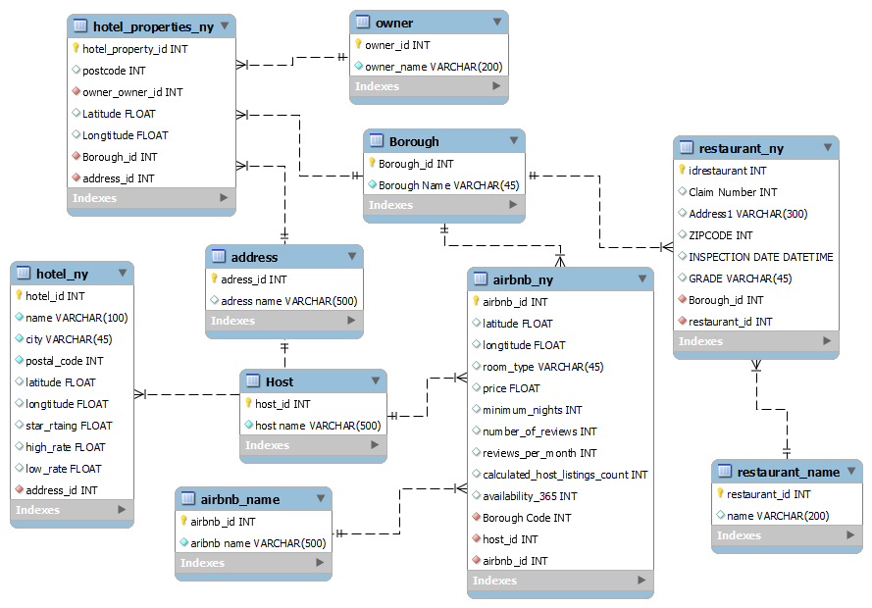
04 Enhanced Entity Relationship Diagram
Executive Summary| Business Use Case | Data Profile & Quality | Tools & Methodology | Analysis & Insights | Recommendations & Lessons Learned| Our Team | Appendix
DESIGN CONSIDERATIONS
Datasets are normalized for easier insertion, update and deletion
Address, host, airbnb_name, Borough, owner, restaurant_name are likely to remain static for long periods of time, so they sit in their own tables.
Hotel_properties_ny, hotel_ny, airbnb_ny, and restaurant_ny data are dynamic, so we stored them in separate tables to make frequent updates easier.
While our database only includes data for New York, we built borough, host, address tables to accommodate more states with the assumption this database would extend to more states when rolled out nationwide
Notes:
oltp

Slide 10
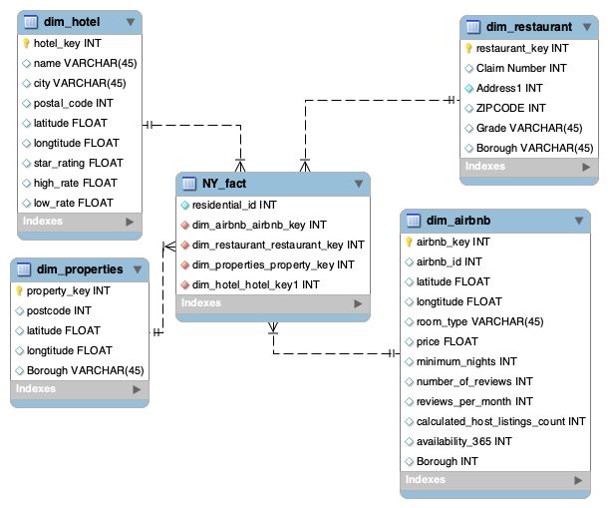
04 Dimensional Model
Executive Summary| Business Use Case | Data Profile & Quality | Tools & Methodology | Analysis & Insights | Recommendations & Lessons Learned| Our Team | Appendix
DESIGN CONSIDERATIONS
Dimensional Model is developed based on the EER model that we constructed.
Dimension tables include dim_hotel, dim_properties, dim_airbnb, and dim_restaurant.
NY_fact table contains all the table keys from the dimension tables listed above.
Multi-dimensional views help users with problem-solving, planning, and decision support
Notes:
OLAP
Online analytical processing

Slide 11
04 Database Design Considerations
Executive Summary| Business Use Case | Data Profile & Quality | Tools & Methodology | Analysis & Insights | Recommendations & Lessons Learned| Our Team | Appendix
Our group designs both OLTP and OLAP databases. We will use OLTP for database design as we expect a large number of data entries and modifications.
Subject-Oriented
Quick Performance
Concurrency & Atomicity
This OLTP database will be used for the purpose of responding immediately to the user requests such as helping hotel & airbnb owners make sound decisions in terms of locating the premises to open their business
Highly effective in resolving insertion, updating and deletion anomalies as well as support the application’s data integrity.
Since Airbnb, hotels, and restaurants information change frequently over time, the OLTP database enables large number of data modifications.
Ability to handle many transaction requests simultaneously and the ability to reliably backup and continue if part of the system fails.
Since we expect large number of users and data entries, OLTP database ensures stable system performance.
Notes:
https://www.tutorialride.com/dbms/online-transaction-processing-oltp-and-online-analytical-processing-olap.htm

Slide 12
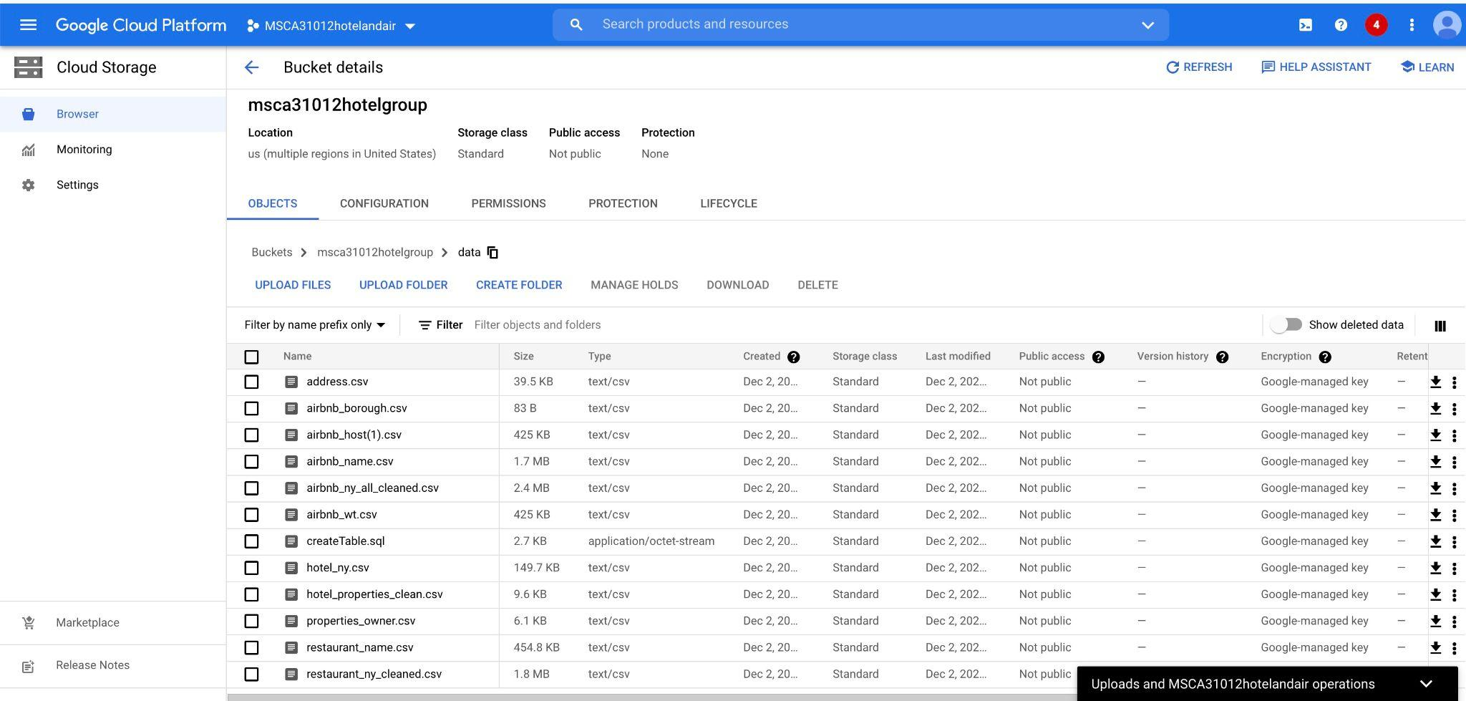
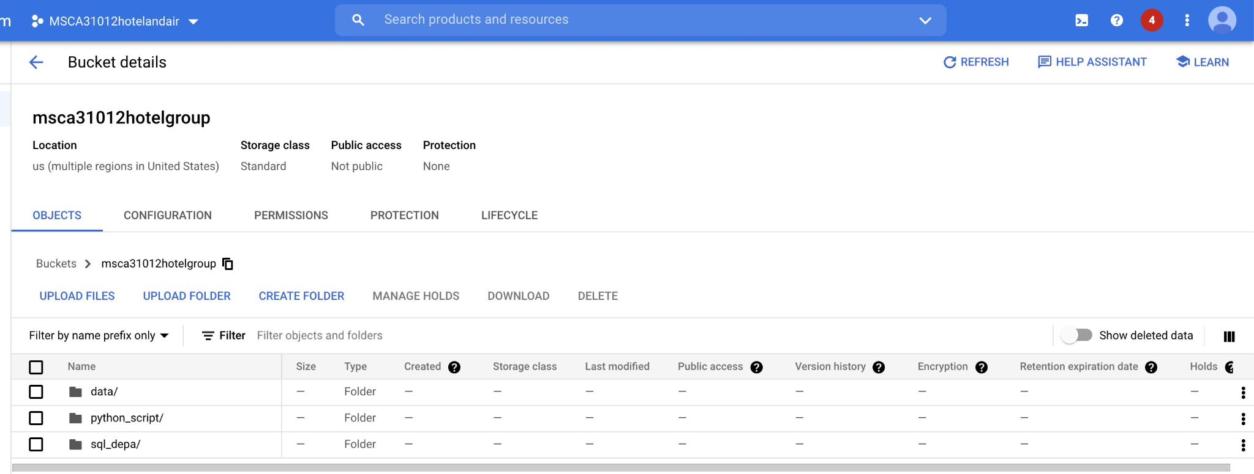
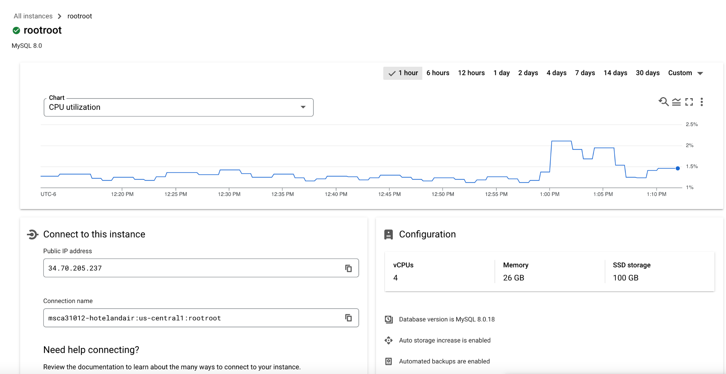
04 Google Cloud Platform (GCP)
Executive Summary| Business Use Case | Data Profile & Quality | Tools & Methodology | Analysis & Insights | Recommendations & Lessons Learned| Our Team | Appendix
We uploaded normalized datasets and coding scripts to GCP to ensure that our works were saved properly. In addition, these data could be used for future collaborations.

Slide 13
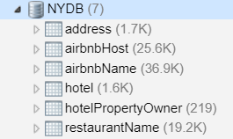
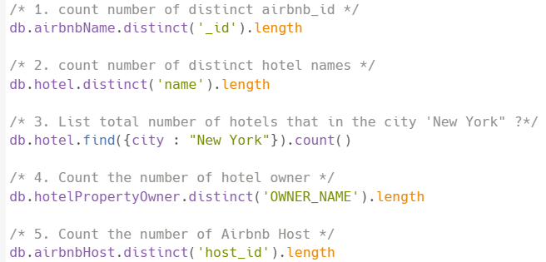
05 MongoDB: Comparison of NY Hotel & Airbnb
Executive Summary| Business Use Case | Data Profile & Quality | Tools & Methodology | Analysis & Insights | Recommendations & Lessons Learned| Our Team | Appendix
Load data to MongoDB
We loaded datasets to MongoDB through command prompt, and we named the database “NYDB.” We queried the total number of hotels and Airbnbs in NY state. We found counts of hotels in NYC. we also queried the number of hotel owners and Airbnb hosts in NY.
As a result, the numbers of NY Airbnb and hosts are much greater than NY hotels and hotel owners. Apparently, Airbnb offers more residential options for travellers and has a competitive advantage.
Output:
36,882 Airbnbs in NY
1,602 hotels in NY,
401 hotels in New York City
219 NY hotel owners
25,650 NY Airbnb hosts
Notes:
Check total number of address that are on xxx street.

Slide 14
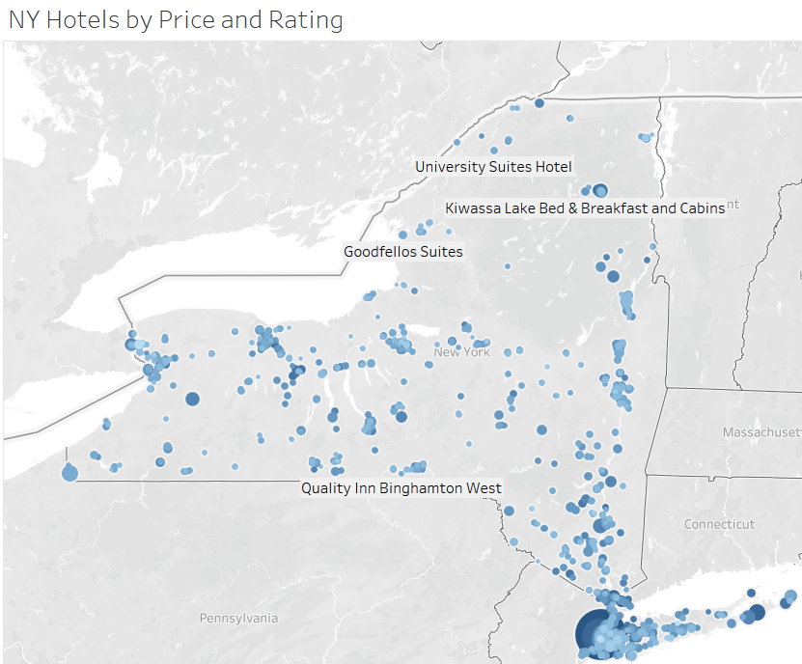
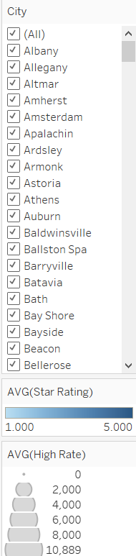
05 Tableau: Analysis of NY Hotels
Executive Summary| Business Use Case | Data Profile & Quality | Tools & Methodology | Analysis & Insights | Recommendations & Lessons Learned| Our Team | Appendix
This graph shows the distribution of hotels in NY state. The graph also displays hotel names, rate, and star rating.
Majority of hotels are in new york city, and hotel prices in NYC are higher than those in other regions.
City was added as a filter, and travellers can use this filter to find desired hotels by region.

Slide 15
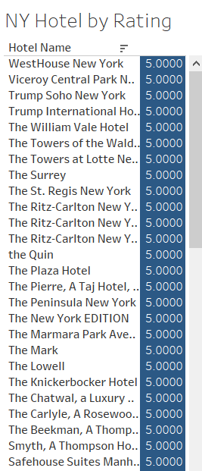
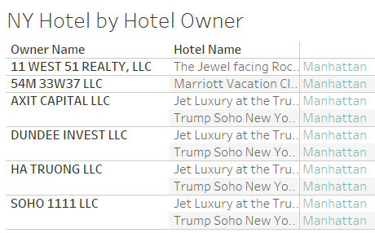
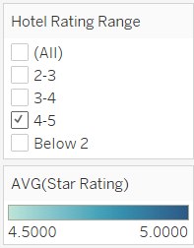
Executive Summary| Business Use Case | Data Profile & Quality | Tools & Methodology | Analysis & Insights | Recommendations & Lessons Learned| Our Team | Appendix
05 Tableau - Analysis of NY Hotel
Since hotel ratings are important factors impacting people’s decision for hotel selection, we divided rating into four categories and added it as a filter. People can view the list of hotels by rating. In this case, we select NY hotels with 4-5 rating.
Hotel rating range calculated field
IF [Star Rating] <= 5 AND [Star Rating] > 4 THEN '4-5'
ELSEIF [Star Rating] <=4 AND [Star Rating] > 3 THEN '3-4'
ELSEIF [Star Rating] <=3 AND [Star Rating] > 2 THEN '2-3'
ELSEIF [Star Rating] > 0 THEN 'Below 2'
END
We also listed hotels in manhattan area and found that Trump Soho New York was owned by three companies, including “AXIT CAPITAL LLC,” “DUNDEE INVEST LLC,” and “SOHO 1111 LLC.”

Slide 16
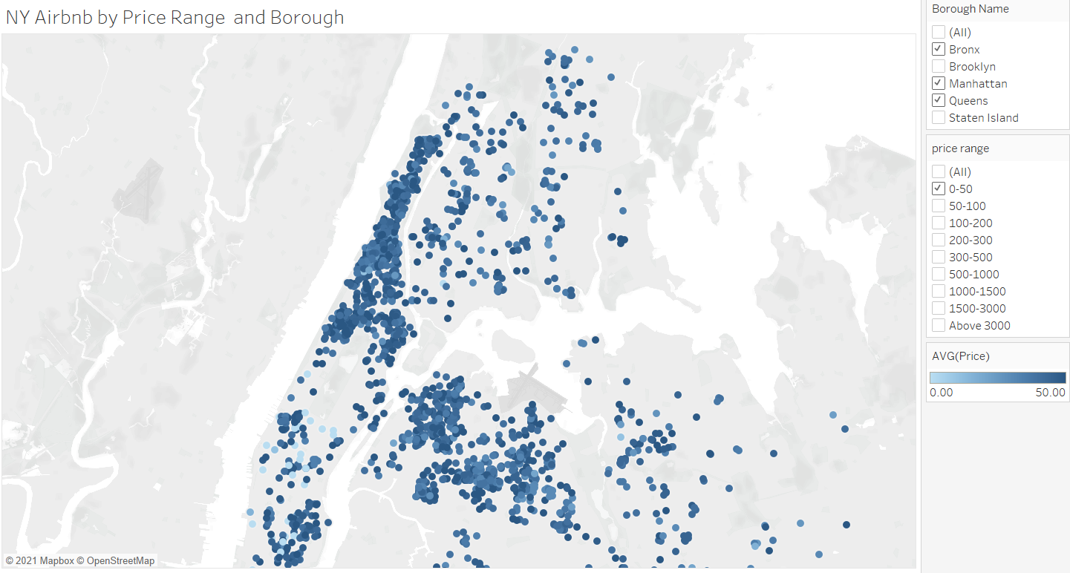
05 Tableau: Analysis of NY Airbnb
Executive Summary| Business Use Case | Data Profile & Quality | Tools & Methodology | Analysis & Insights | Recommendations & Lessons Learned| Our Team | Appendix
We divided Airbnb prices into nine ranges and added “borough” and “price range” as filters. In this case, we filtered Airbnbs in Bronx, Manhattan, and Queens with price below $50 per night. Travellers can use these filters to search for desired Airbnbs based on price and location.
Price range calculated field:
IF [Price] <= 50 AND [Price] >= 0 THEN '0-50'
ELSEIF [Price] <= 100 AND [Price] > 50 THEN '50-100'
ELSEIF [Price] <= 200 AND [Price] > 100 THEN '100-200'
ELSEIF [Price] <= 300 AND [Price] > 200 THEN '200-300'
ELSEIF [Price] <= 500 AND [Price] > 300 THEN '300-500'
ELSEIF [Price] <= 1000 AND [Price] > 500 THEN '500-1000'
ELSEIF [Price] <= 1500 AND [Price] > 1000 THEN '1000-1500'
ELSEIF [Price] <= 3000 AND [Price] > 1500 THEN '1500-3000'
ELSEIF [Price] > 3000 THEN 'Above 3000'
END

Slide 17
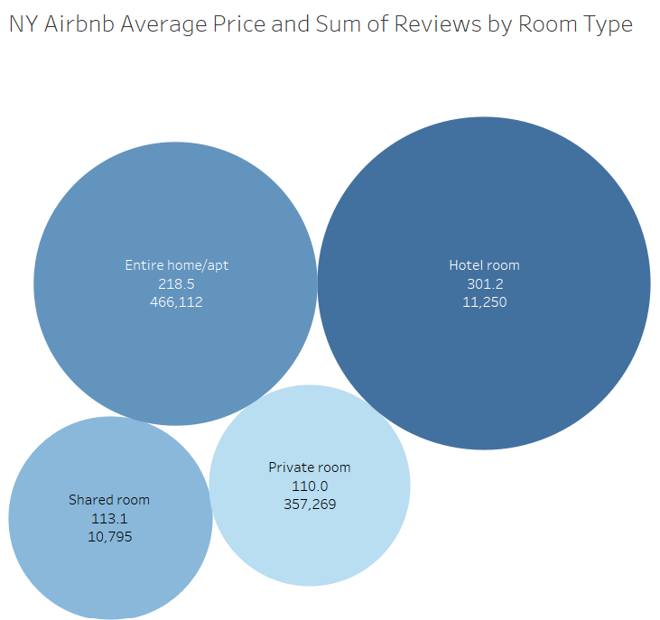
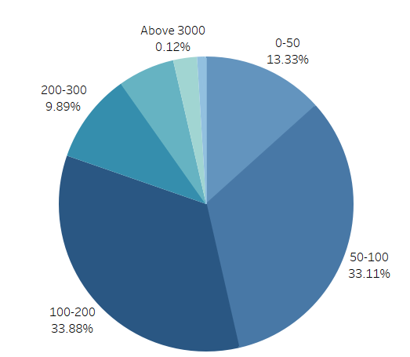
05 Tableau: Analysis of NY Airbnb
Executive Summary| Business Use Case | Data Profile & Quality | Tools & Methodology | Analysis & Insights | Recommendations & Lessons Learned| Our Team | Appendix
The left graph shows that majority (67%) Airbnbs are priced between $50 - $200 per night.
The right graph shows that Hotel room is the most expensive room type ($301.2 per night).
Entire home/apt is the most popular room type, as it has the highest number of reviews (466,112 reviews).

Slide 18
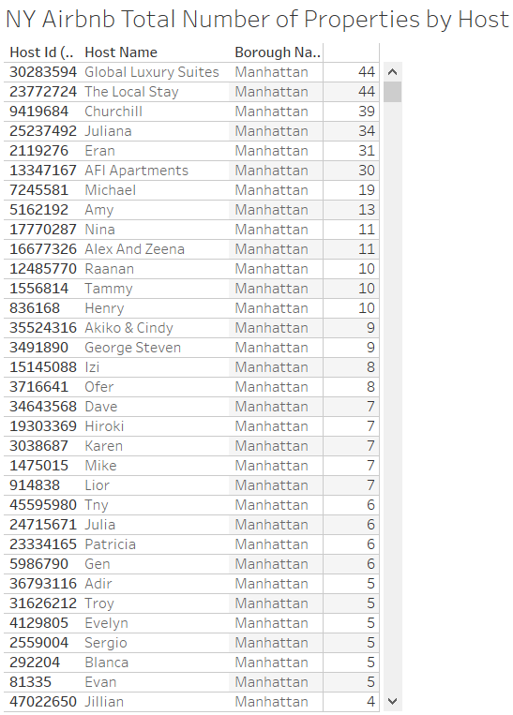
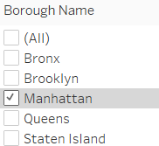
05 Tableau: Analysis of NY Airbnb
Executive Summary| Business Use Case | Data Profile & Quality | Tools & Methodology | Analysis & Insights | Recommendations & Lessons Learned| Our Team | Appendix
We counted the number of properties by Airbnb host and added borough as a filter. People can use this filter to identify regional hosts with large number of properties. By connecting with these hosts, people can have a better understanding to regional Airbnb prices and availability.
In this case, the table shows that “Global Luxury Suites”, “The Local Stay”, “Churchill”, “Juliana”, and “Eran” are the top 5 airbnb hosts who possess highest number of properties in Manhattan, which means that they together own significant amount of Airbnb market share in that region.

Slide 19
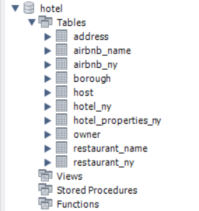
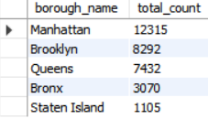
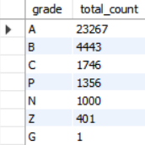
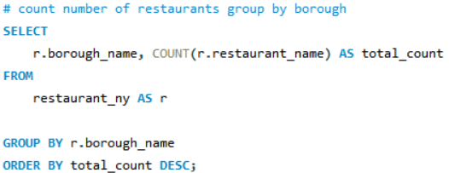
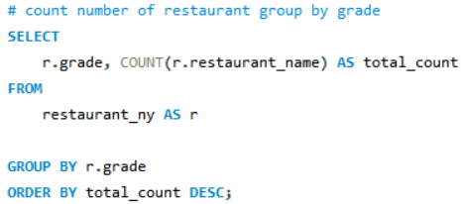
05 MySQL Workbench: Analysis of NY Restaurant
Executive Summary| Business Use Case | Data Profile & Quality | Tools & Methodology | Analysis & Insights | Recommendations & Lessons Learned| Our Team | Appendix
Load Data to hotel schema
# of Restaurants by borough
We created hotel schema, loaded csv datasets to sql workbench through Import Wizard, and queried number of restaurants by borough and grade.
We find that Manhattan has the largest number of restaurants, while Staten Island has the least number of restaurants. In addition, 23,267 of restaurants have A grade.
# of Restaurants by grade
Notes:
Check the number of hotels named Hyatt, Trump, etc.
Check the total number of airbnbs owned by xxx.
Check the number of restaurants that are named xxx.
Check the number of hosts that has first/last name xxx.

Slide 20
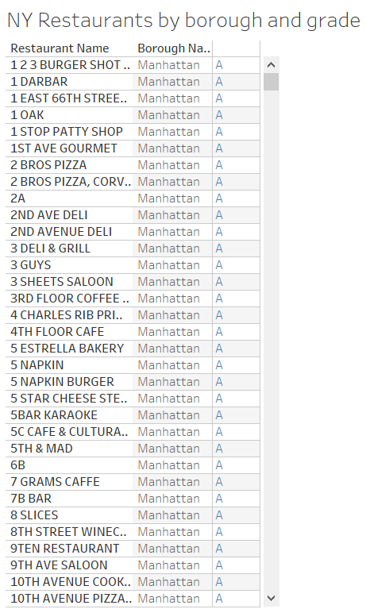
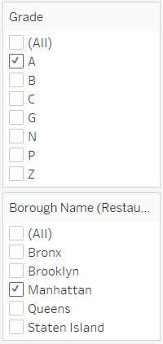
05 Tableau: Analysis of NY Restaurant
Executive Summary| Business Use Case | Data Profile & Quality | Tools & Methodology | Analysis & Insights | Recommendations & Lessons Learned| Our Team | Appendix
We created a table displaying each restaurant and corresponding grade. We added grade, borough as filters so that people can use them to search for qualitative restaurants in different regions. In this graph we show a list of restaurants with A grade in Manhattan.
The filters would also be great for people to look up restaurants that they should avoid due to sanitize issues.

Slide 21
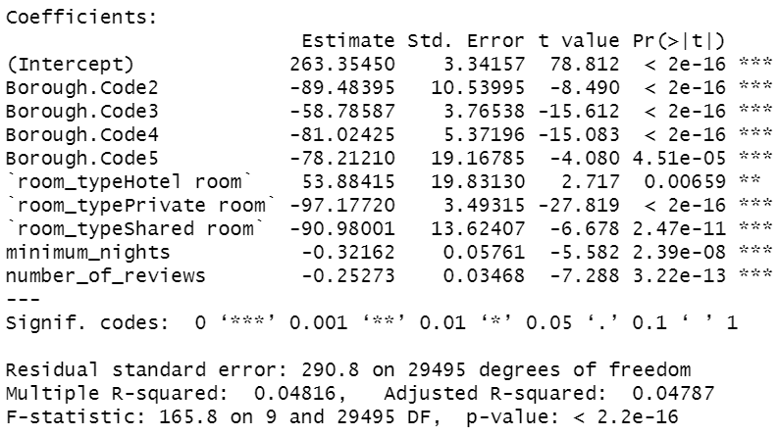
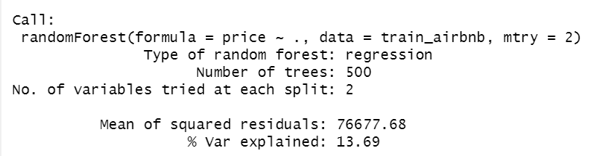
05 Statistical Analysis: Simple Linear Regression
Executive Summary| Business Use Case | Data Profile & Quality | Tools & Methodology | Analysis & Insights | Recommendations & Lessons Learned| Our Team | Appendix
With R studio, we analyzed NY Airbnbs using simple linear regression in and studied factors that associate with Airbnb prices. We splitted data into 80% training data and 20% testing data. To choose related variables, we used stepwise forward method for model selection
Model: price~borough+room_type+ minimum nights+number of reviews
The significant p-values indicate that borough code, room_type, minimum nights, and number of reviews are important factors impacting Airbnb price.
The R^2 is low while p-value is statistically significant, indicating that the relationship between y and x could be non-linear. (However, from random forest(non linear model), the % of variation explained is still low, 13.69%) It means further research needs to be done to find more related variables.

Slide 22
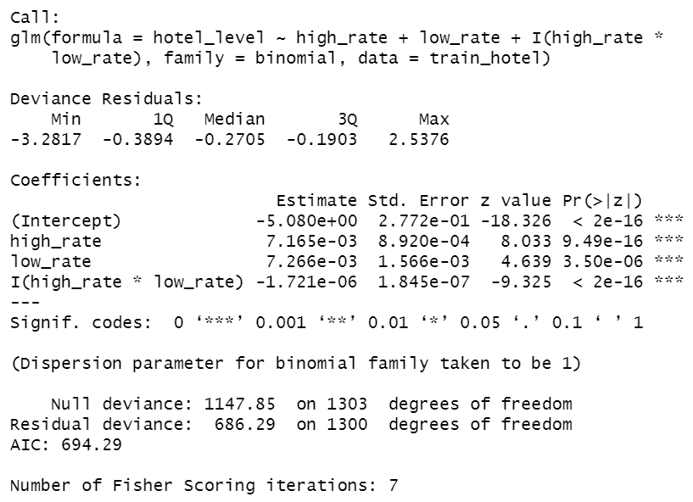
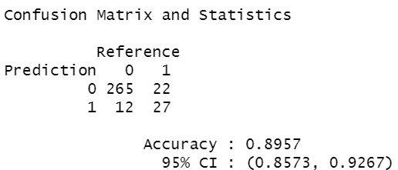
05 Statistical Analysis: Logistic Regression
Executive Summary| Business Use Case | Data Profile & Quality | Tools & Methodology | Analysis & Insights | Recommendations & Lessons Learned| Our Team | Appendix
With R studio, we analyzed NY hotels using logistic regression and studied factors that associate with hotel rating. We splitted data into 80% training data and 20% testing data.
Model: hotel_level~high_rate+low_rate+I(high_rate*low_rate)
After testing variables, we find high price , low price, and the correlation term are important factors. The model accuracy for test dataset is 90%
We split hotel rating into two categories and named the variable “hotel_level”
hotel_ny$hotel_level=ifelse(hotel_ny$star_rating>=4,1,0)

Slide 23
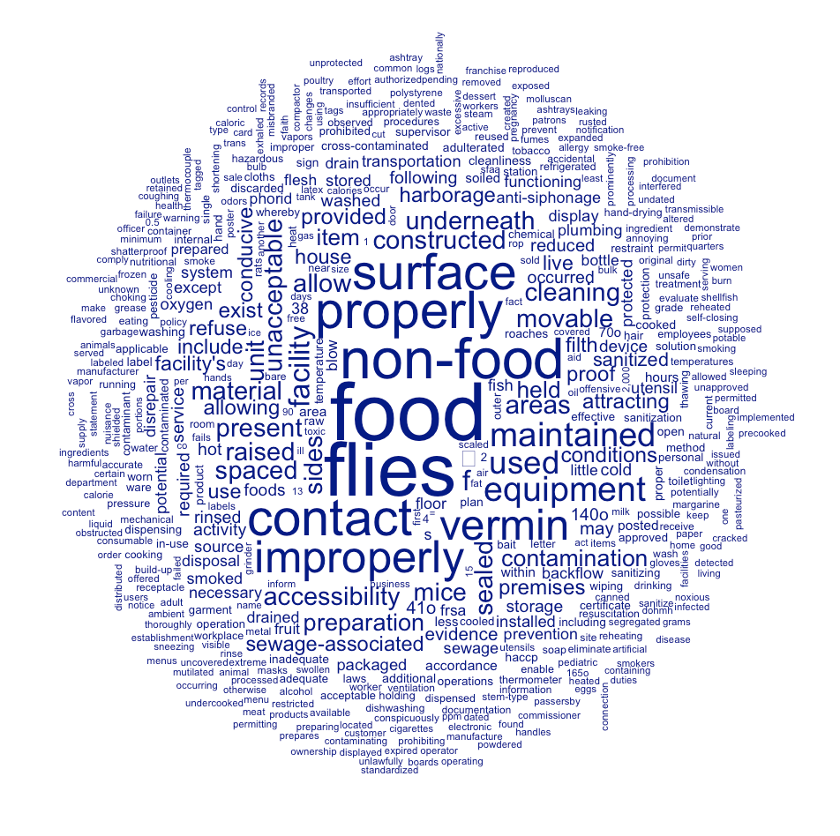
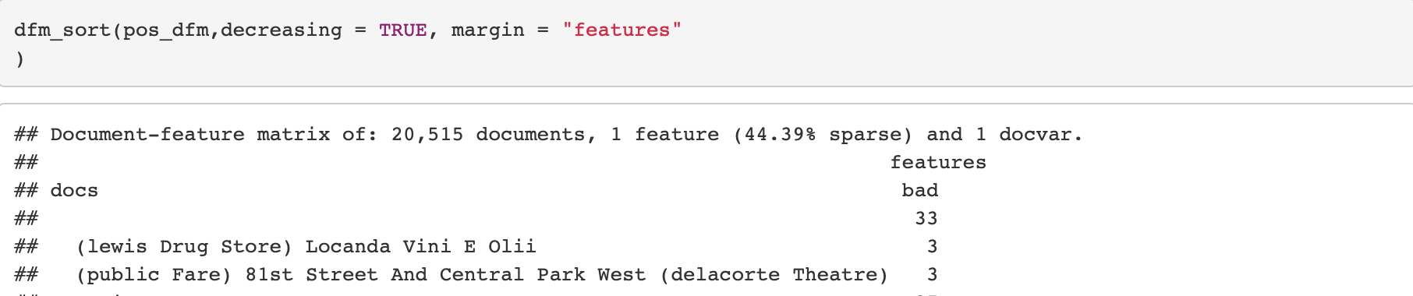
05 Statistical Analysis: Text Mining
Executive Summary| Business Use Case | Data Profile & Quality | Tools & Methodology | Analysis & Insights | Recommendations & Lessons Learned| Our Team | Appendix
We use restaurant dataset for text analysis. We first inspect violation comments and count word frequencies to identify common problems. Then, we build a word cloud to visualize.
We find key words like flies and vermin(mouse) are frequently mentioned. By putting the key words in context, we find that vermin only refers to no protection against mouse pollution. but flies indicate that besides no protection against files, clients actually see flies in restaurants..
We group comments by different restaurants. We build a dictionary only include “flies” and “vermin” to see the top restaurant to avoid in nyc: Locanda Vini E Olii

Slide 24
06 Lessons Learned
Executive Summary| Business Use Case | Data Profile & Quality | Tools & Methodology | Analysis & Insights | Recommendations & Lessons Learned| Our Team | Appendix
01
The “hotel_ny” dataset contains information about city, while the rest of datasets include borough as geographic information. For better visualization and analysis purpose, we will make sure that all datasets are consistent in the future.
02
Our linear regression model has low R-square value and does not fit Airbnb data well. We should add more independent variables to improve the fit.
03
The Import Wizard feature in MySQL workbench is time-consuming and involves many manual works, which make large data import infeasible.
04
We have a better understanding to data pipeline after incorporating different data tools in this project.
Notes:
Our linear regression model has low R-square value and does not fit Airbnb data well. We should add more independent variables to improve the value.
Our group has imported denormalized datasets into Neo4j,
We have a better understanding to data pipeline after incorporating different data tools in this project.
When dealing with large, unorganized data, we have learned how to debug new issues
More information about restaurant such as average price, rating, geographical information, etc can be added for more comprehensive analysis.

Slide 25







06 Recommendations
Executive Summary| Business Use Case | Data Profile & Quality | Tools & Methodology | Analysis & Insights | Recommendations & Lessons Learned| Our Team | Appendix
Currently, our database are suitable for users to perform operations such as insert, update, and delete hotel and airbnb data.
01
As volume of data increases, use GCP to load the data into SQL instead of using import wizard.
Use python to web scrape and collect Airbnb and hotel real time data to update our database with most recent information. Some ideal websites include Booking, Tripadvisor, Airbnb, Expedia, etc.
02
03
With real-time data, we can conduct time series analysis to identify trends and systematic patterns as well as making predictions

Slide 26




07 Our Team
Executive Summary| Business Use Case | Data Profile & Quality | Tools & Methodology | Analysis & Insights | Recommendations & Lessons Learned| Our Team | Appendix
Naibo Hu(Ray)
Fan Fei (Fiona)
Zihao Liu
Pengfei Gu (David)

Slide 27
08 Appendix

Slide 28
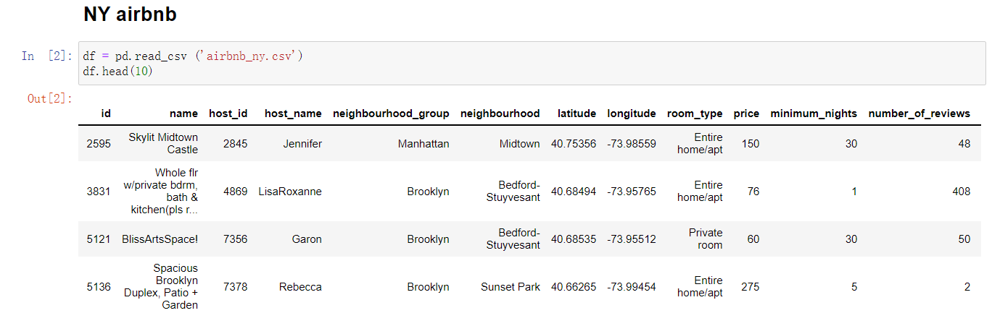
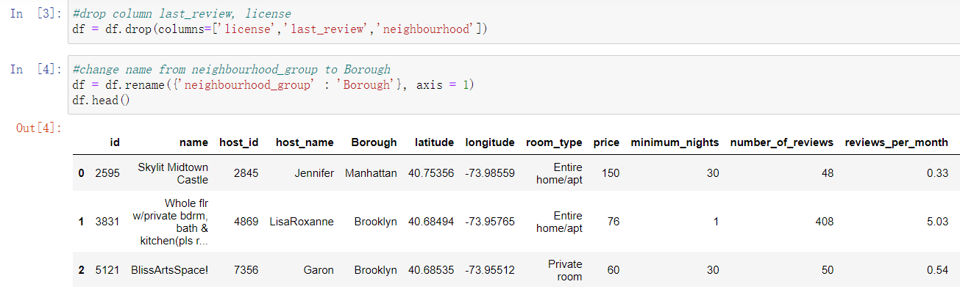
Data ETL Python: NY Airbnb

Slide 29
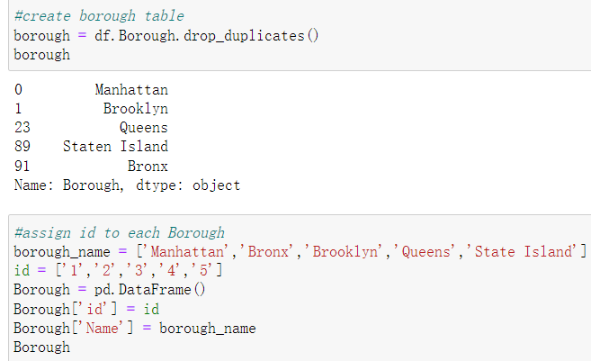
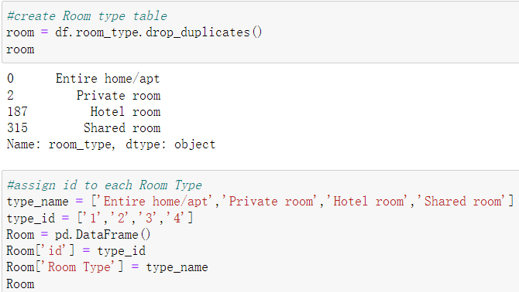
Data ETL Python: NY Airbnb

Slide 30
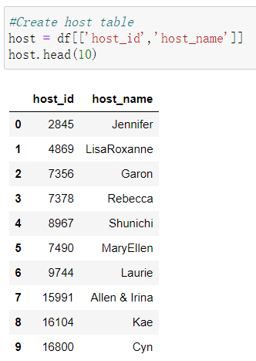
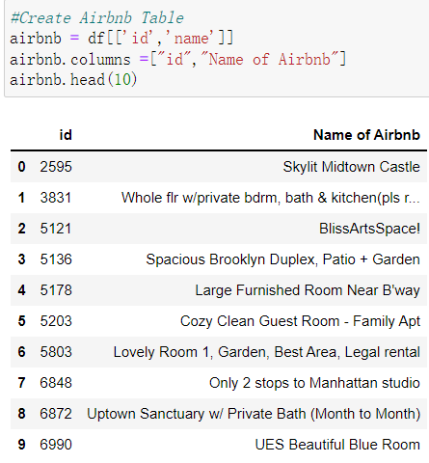
Data ETL Python: NY Airbnb

Slide 31
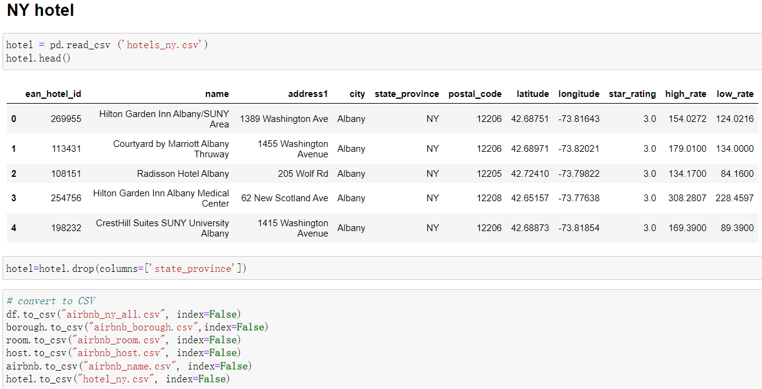
Data ETL Python: NY Hotel

Slide 32
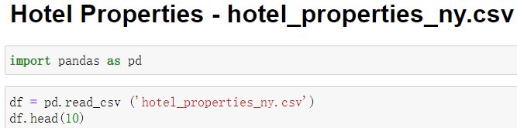
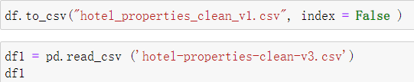
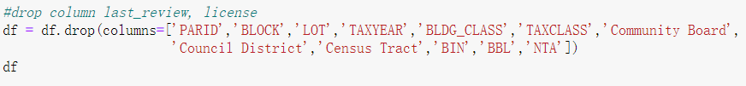
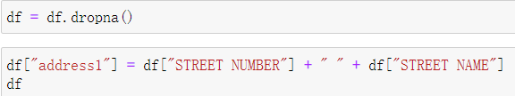
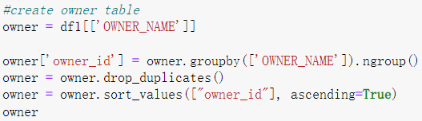
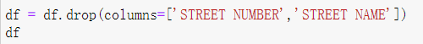
Data ETL Python: NY Hotel

Slide 33
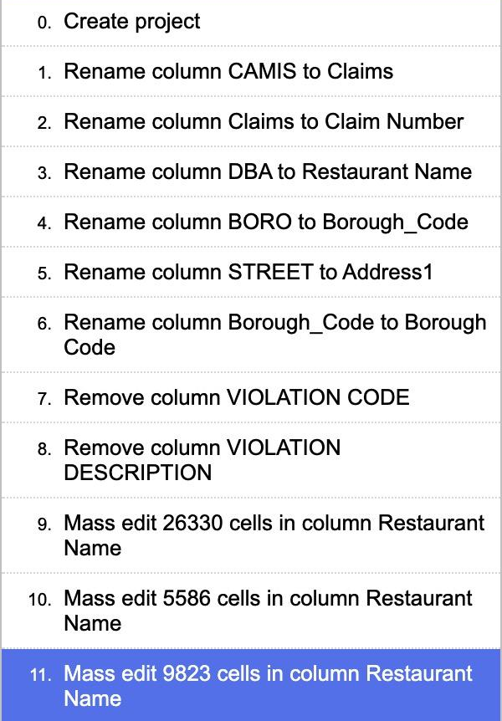
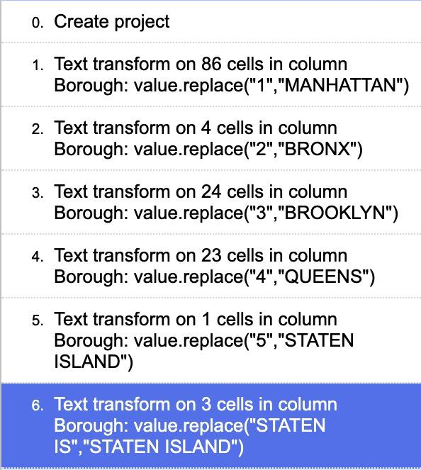
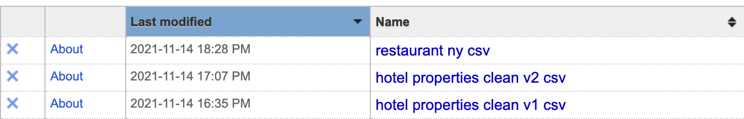
Data ETL OpenRefine: Hotel Properties & Restaurant

Slide 34
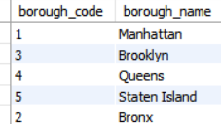
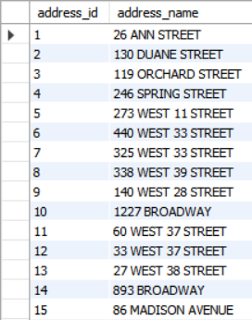
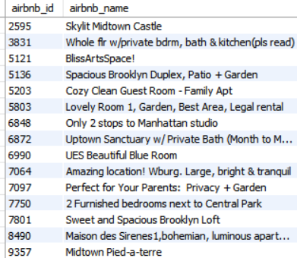

SQL Data Import
borough
address
airbnb_name
host

Slide 35


SQL Data Import
airbnb_ny
hotel_ny

Slide 36




SQL Data Import
hotel_properties_ny
restaurant_ny
Owner
restaurant_name

Slide 37



Neo4j Data Import
restaurant_ny
hotel_ny
airbnb_ny

Slide 38

Connect Sql to Tableau

Slide 39

Tableau Dashboard

Slide 40

Topic MODEL For Text Analysis
```{r}
set.seed(100)
if (require("stm")) {
my_lda_fit5 <- stm(mydfm_nostops, K = 5, verbose = FALSE)
plot(my_lda_fit5)
}
```
We set k=5 for topic model from deep learning to find potential topics of inspection comments. We believe there are 3 main themes from human review: food service, food storage,and food cleanliness. We choose not to put this in main part because further study and better data sets for comments are needed to get a more precise insights.

Slide 41
08 Reference

Slide 42
NY Hotel Dataset:
https://datasetsearch.research.google.com/search?query=new%20york%20hotels&docid=L2cvMTFqOWMwOHkzNQ%3D%3D
NY Hotel Properties:
https://data.cityofnewyork.us/City-Government/Hotels-Properties-Citywide/tjus-cn27
NY Airbnb:
http://insideairbnb.com/get-the-data.html
NY Restaurant:
https://data.cityofnewyork.us/Health/restaurant-data-set-2/f6tk-2b7a

